Slide 1
The Age of Exploration

Slide 2
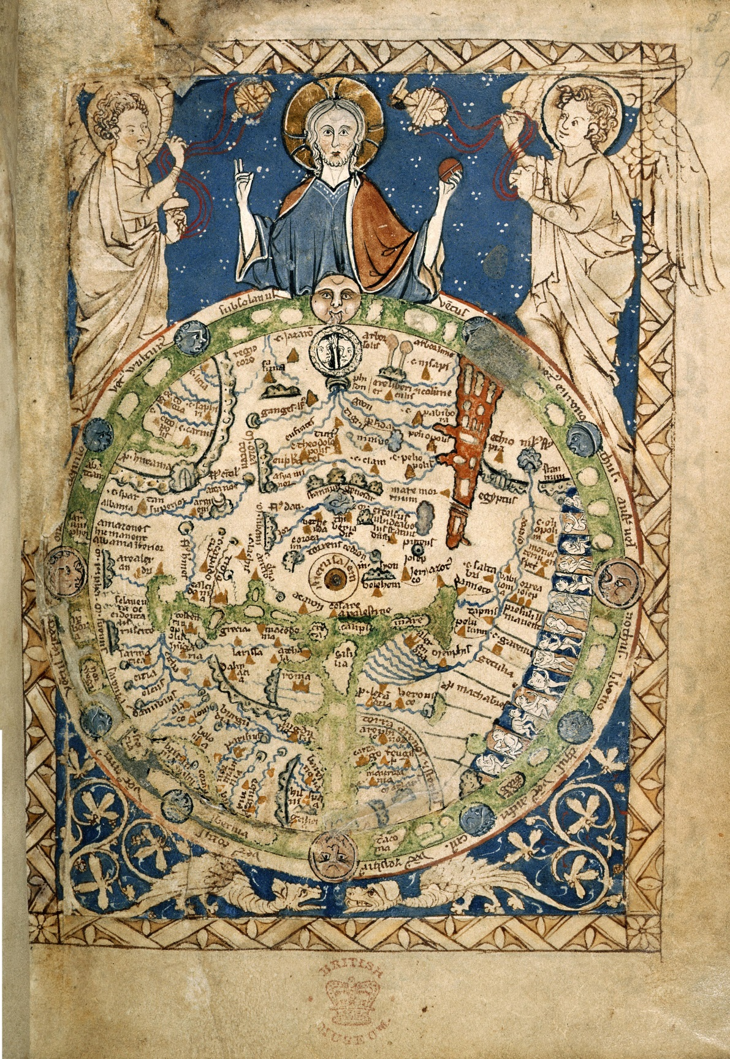
Psalter world map, 13C

Slide 3
Schoner World Map 1520

Slide 4
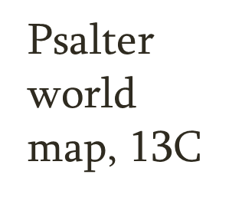
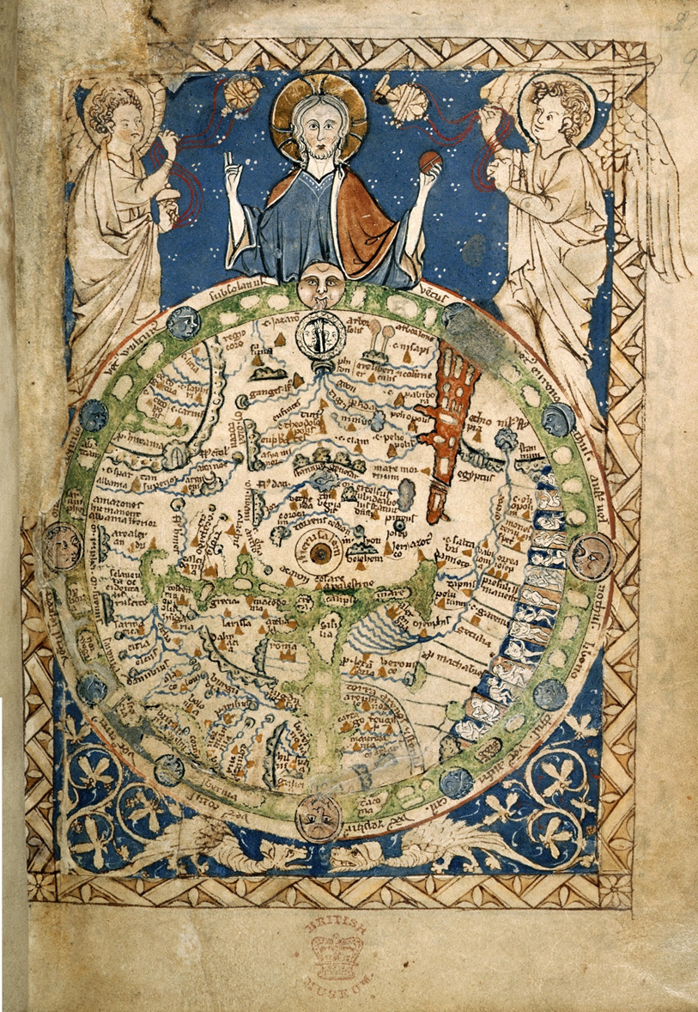
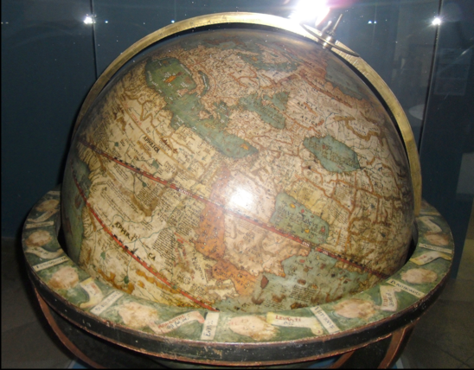
Schoner World Map 1520

Slide 5
I. Intro
Changed the balance of power as well as the European intellectual universe
Mediterranean/Baltic Seas as center => Atlantic seaboard
Universal Church => whole hemisphere of people never heard of Christ

Slide 6
II. Motives
God, gold, and glory: not mutually exclusive!
Spices of Asia (bypass Venetians, Ottomans)
Overland route (Spice Road) no longer profitable in 15C
Dull Euro diet needs pepper and cloves
Renaissance (secular) mentality

Slide 7
III. Means
Technological innovations
Caravel and Galleon
Magnetic Compass
Astrolabe and quadrant
Mapmaking
$ from banking
Bankers saw lucrative investment
Successful voyages =40x initial cost)

Slide 8
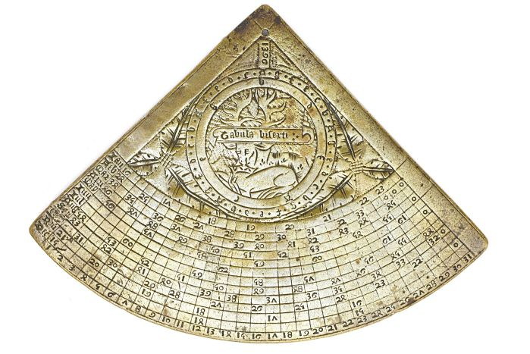

Slide 9
IV. Spanish Exp.
Columbus
Ferdinand and Isabella
Crew thinks crazy (world too big…)
Upon arrival: thinks he’s in Japan
Observed how easily enslaved natives were…

Slide 10
Spanish Expl. (cont.)
Conquistadores
discovery of New World right on heels of Spanish reconquesta (Castilians)
Religious zeal + desire for gold
Hernan Cortes: Aztecs 1521
Pizarro: Incas 1532

