Slide 1
Renaissance Art

Slide 2
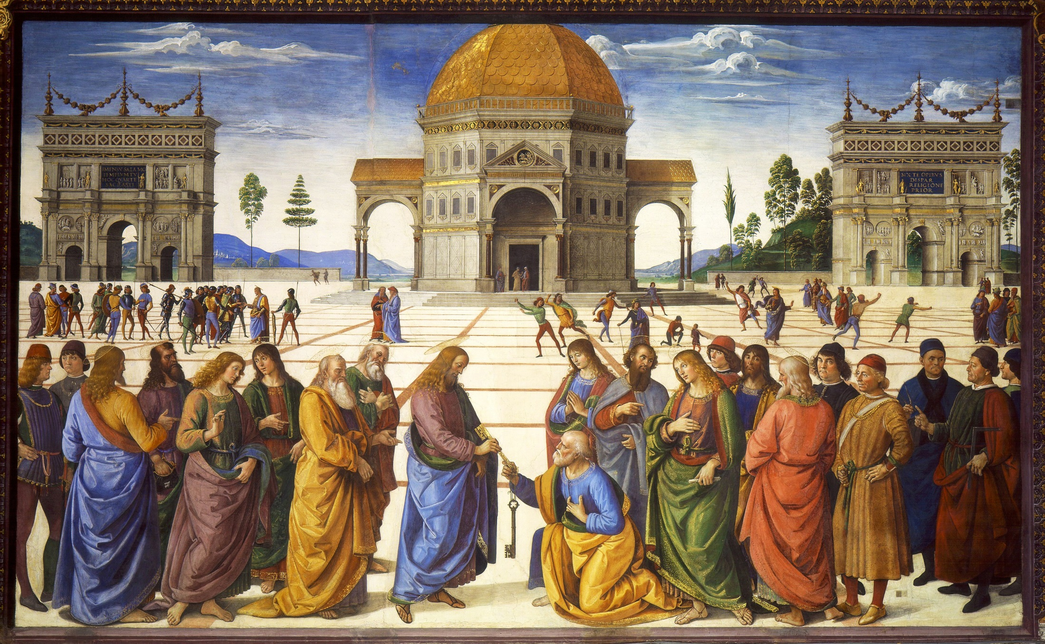
1481-2, Delivery of the Keys, Pietro Perugino (fresco, Sistine Chapel)

Slide 3
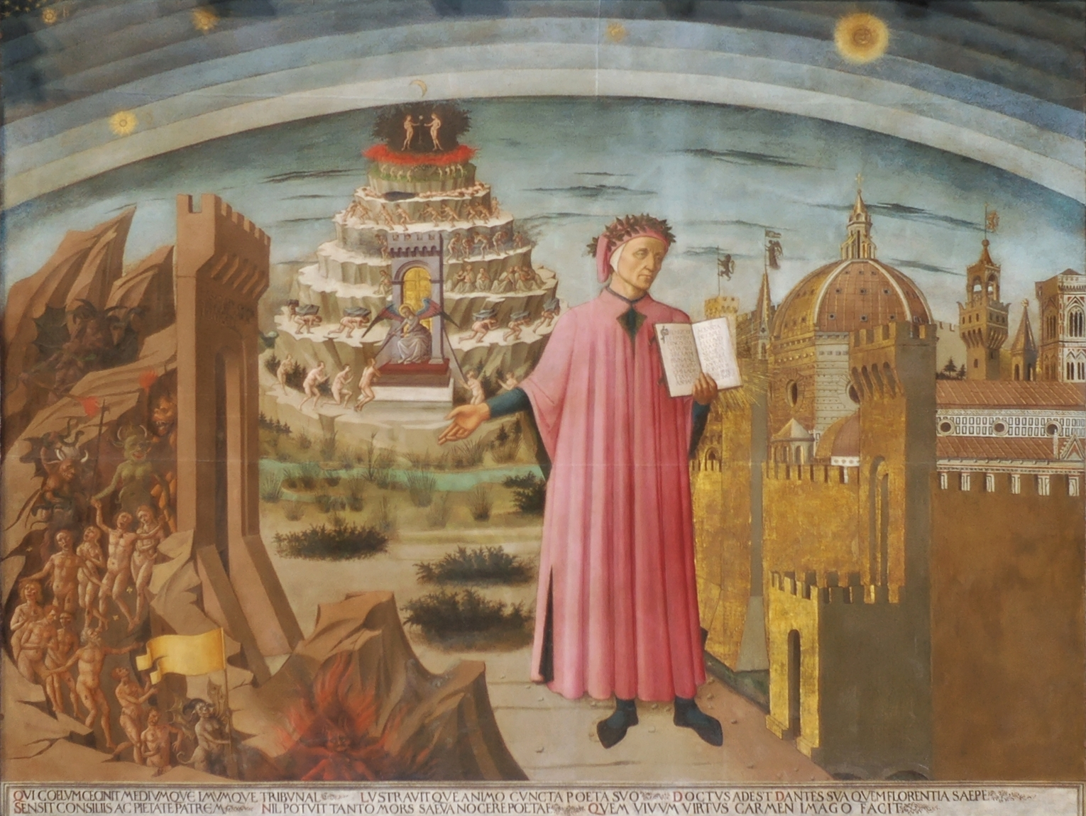
1465, Dante Before the City of Florence, Domenico di Michelino (fresco, Florence cathedral)

Slide 4
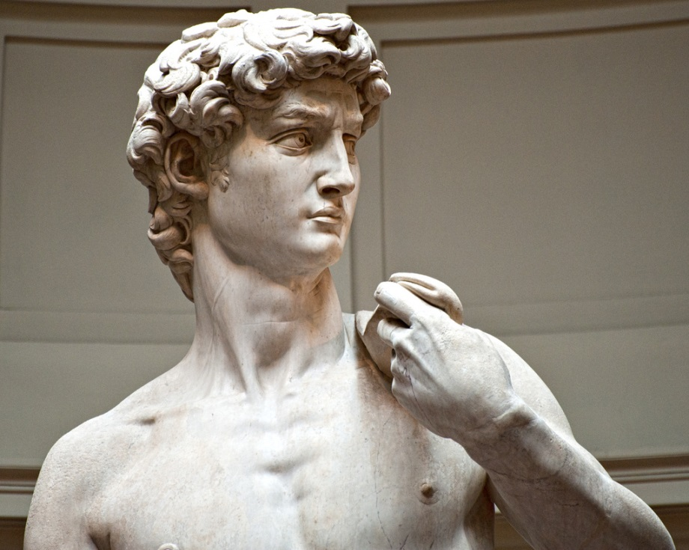
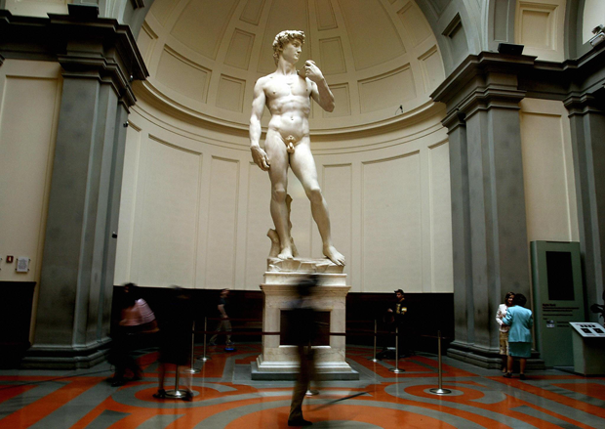
David, Michelangelo, 1501-1504

Slide 5
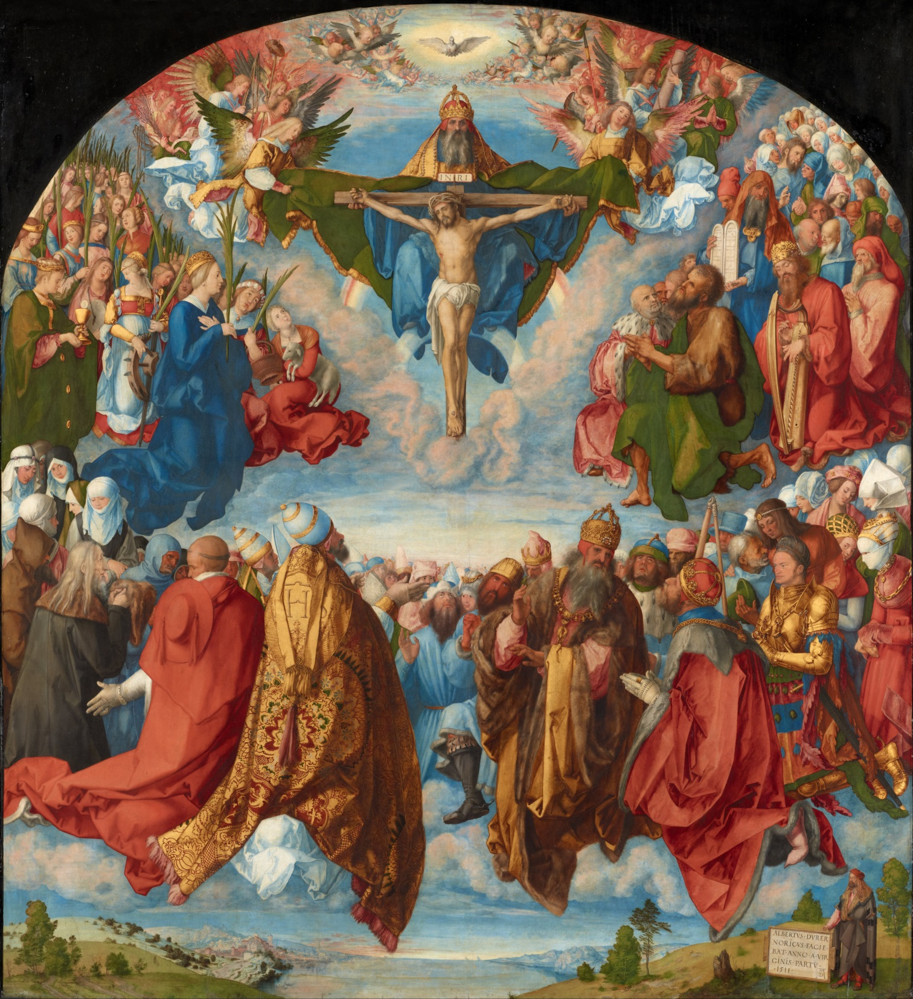
1511, Adoration of the Trinity, Albrecht Dürer (oil on panel, Landauer Altar)

Slide 6
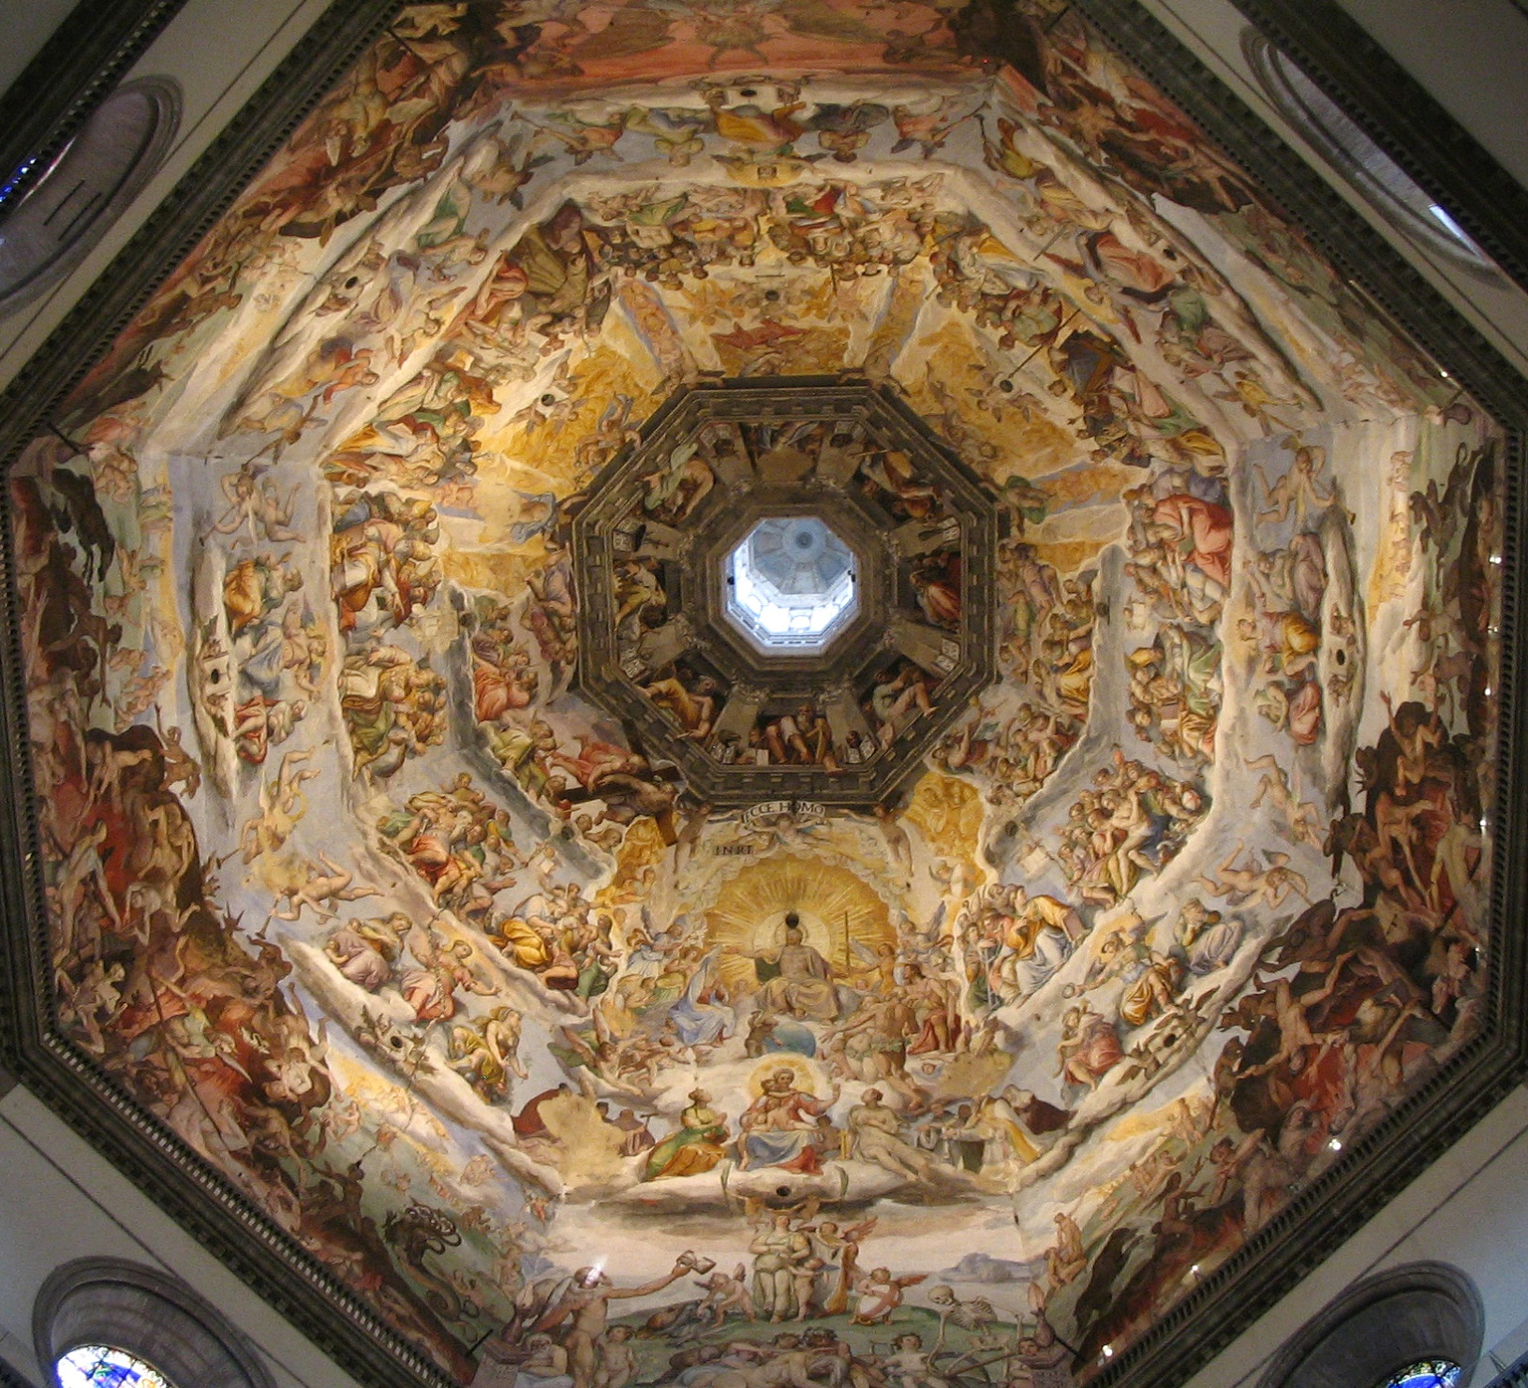

Slide 7
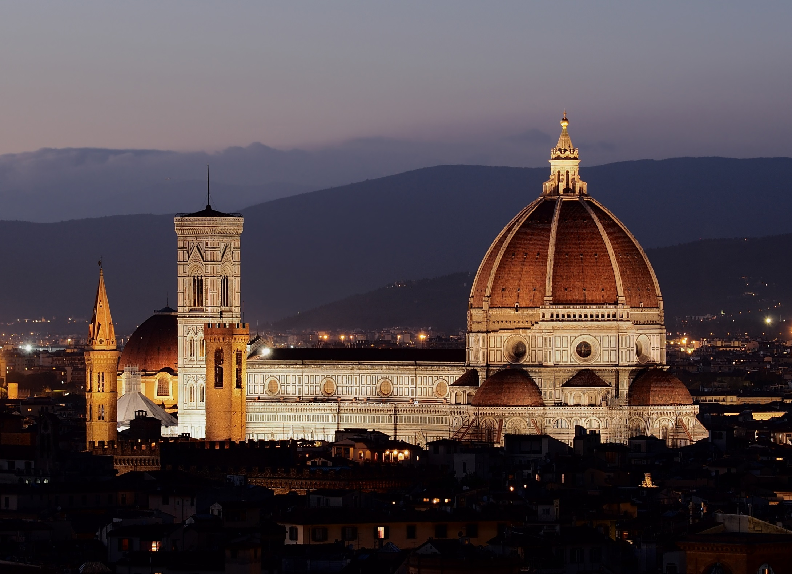
1436, Florence Cathedral, Filippo Brunelleschi (dome architect)

Slide 8
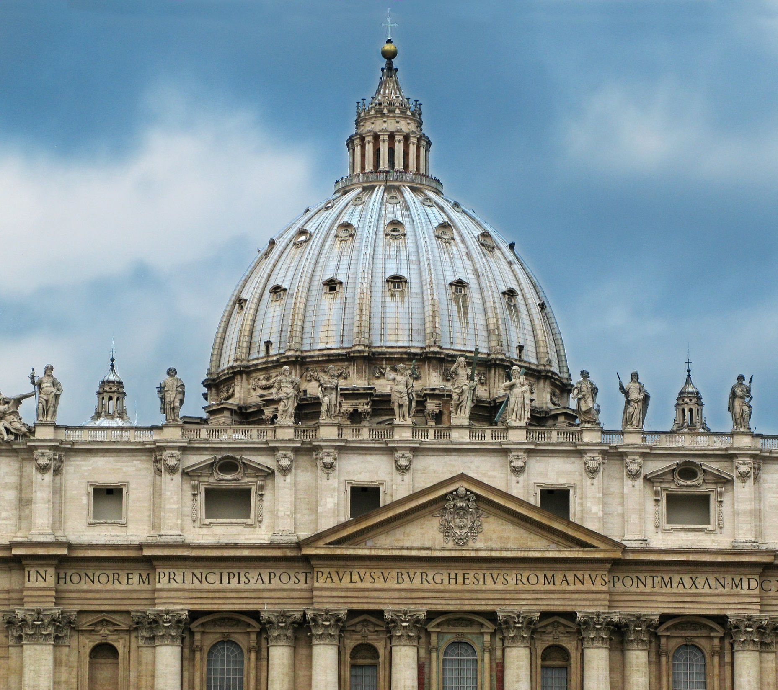
St. Peter’s Basilica Dome, 1506-1626

Slide 9
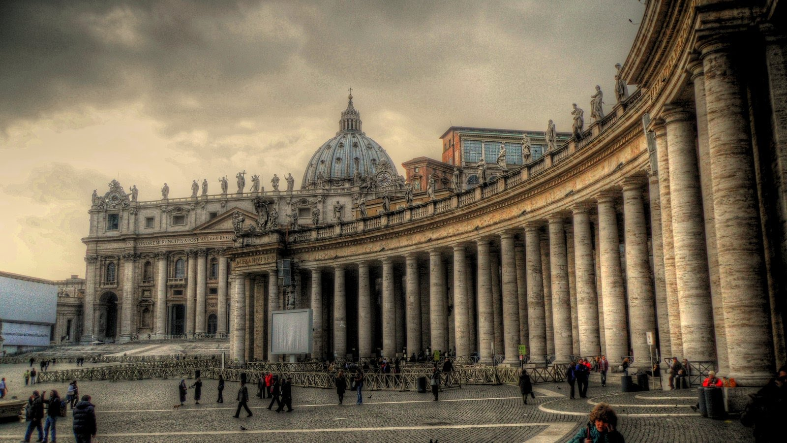

Slide 10
Humanism in Art and Architecture
Linear (one-point, geometric) perspective
Mixing of Christian and Classical Subjects
Ad fontes
Glorification of the Human body/potential
Neo-Platonism
Civic Humanism
Virtus!

