Slide 1
Exploration: Motives and Means

Slide 2
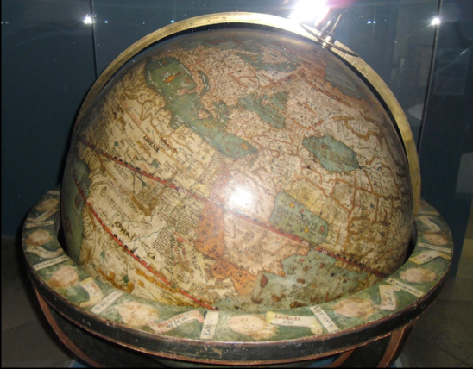
I. Intro
Changed the balance of power as well as the European intellectual universe
Mediterranean/Baltic Seas as center => Atlantic seaboard
Land connection with Asia => naval power
Universal Church => whole hemisphere of people never heard of Christ

Slide 3
II. Motives
God, gold, and glory: not mutually exclusive!
Spices of Asia (bypass Venetians, Ottomans)
Overland route (Spice Road) no longer profitable in 15C
Dull Euro diet needs pepper and cloves
Renaissance (secular) mentality

Slide 4
III. Means
Technological innovations
Caravel and Galleon
Magnetic Compass
Astrolabe and quadrant
Mapmaking
$ from banking
Bankers saw lucrative investment
Successful voyages =40x initial cost)

Slide 5
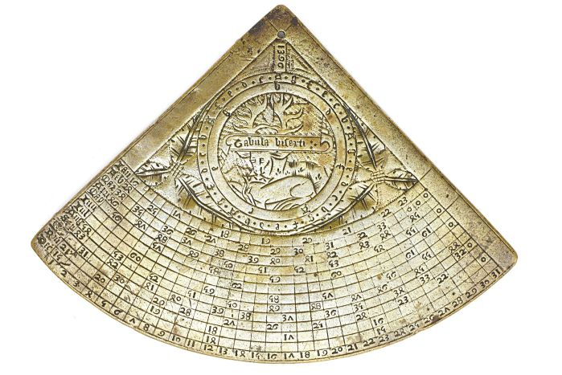

Slide 6
IV. Spanish Exp.
Columbus
Ferdinand and Isabella
Crew thinks crazy (world too big…)
Upon arrival: thinks he’s in Japan
Observed how easily enslaved natives were…

Slide 7
Spanish Expl. (cont.)
Conquistadores
discovery of New World right on heels of Spanish reconquesta (Castilians)
Religious zeal + desire for gold
Hernan Cortes: Aztecs 1521
Pizarro: Incas 1532

Slide 8
Spanish Expl. (cont.)
Spain’s power:
Gunpowder/horse advantage
New Spain empire, slavery
Unintentional: disease spreads ahead of conquerors

Slide 9
V. Reactions
Valladolid debate
Sepulveda- Only Christians can have legit government
Bartolome de Las Casas- Indians have rational government, not just war!
Disease exchange, wipes out great deal of indigenous peoples

