Slide 1
Humanism
Grew out of early traditions of professional teaching in rhetoric and grammar in medieval Italian schools
NEW: Emphasis on classical studies, imitating the classics- ideal of literary elegance reached through Roman authors
AD FONTES “[back] to the sources”: humanist motto
Valla and Donation of Constantine
Civic Humanism: use studia humanitas for good of the city
VIRTUS
Vergerius
Castiglione
Machiavelli

Slide 2
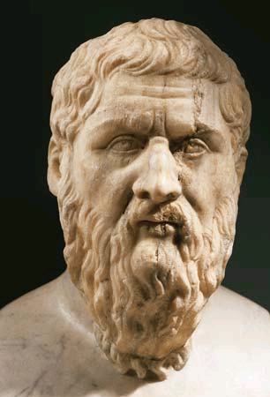
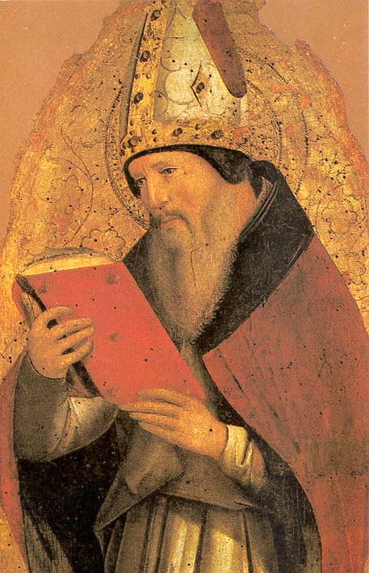
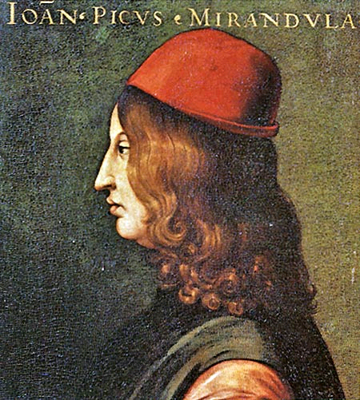
Neo-Platonism
Brought over to Italy in early15C by Byzantine scholars
Florentine Academy
Augustine- use Plato to further knowledge of God
Pico della Mirandola- man has choice between angels and animals (mutable human nature)

Slide 3
The New Monarchs (c. 1450-1500)

Slide 4
Bellwork Tues. 8/9
Follow unpacking procedures
Get out your notes from yesterday along with your picture order forms.
We will begin as soon as the bell rings.

Slide 5
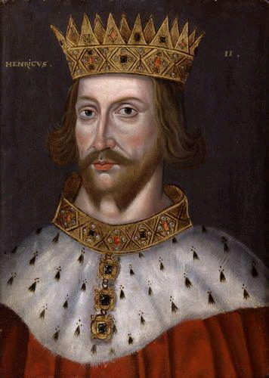
Middle Ages
Monarchy: theoretical => actual power
Tools of Monarchical centralization in 15C:
Law: King=fount of Justice
Taxes
War
Hereditary powers

Slide 6
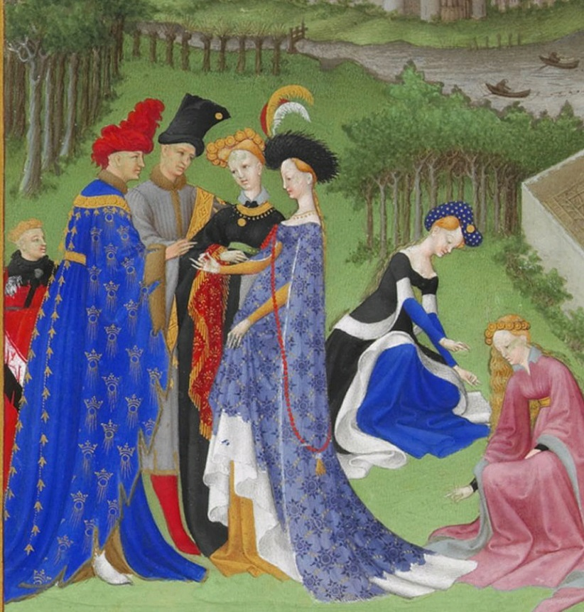
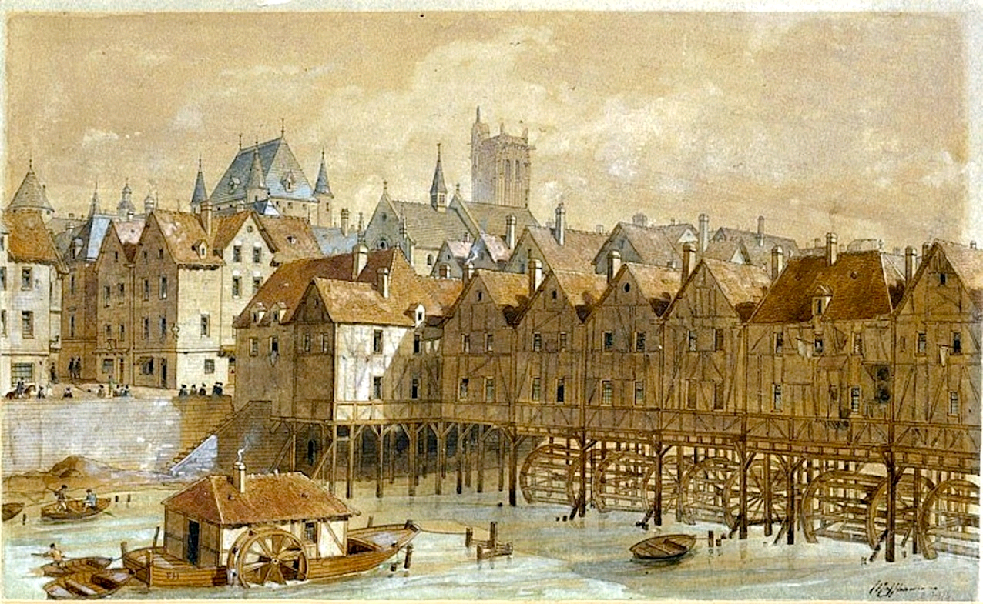
15th century Problems
Nobles
“Every baron is sovereign in his own barony”
“over-mighty subjects” destroy common good
Towns and merchants: Go to the LAW: Form alliance w/ King against selfish nobles

Slide 7
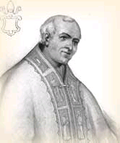
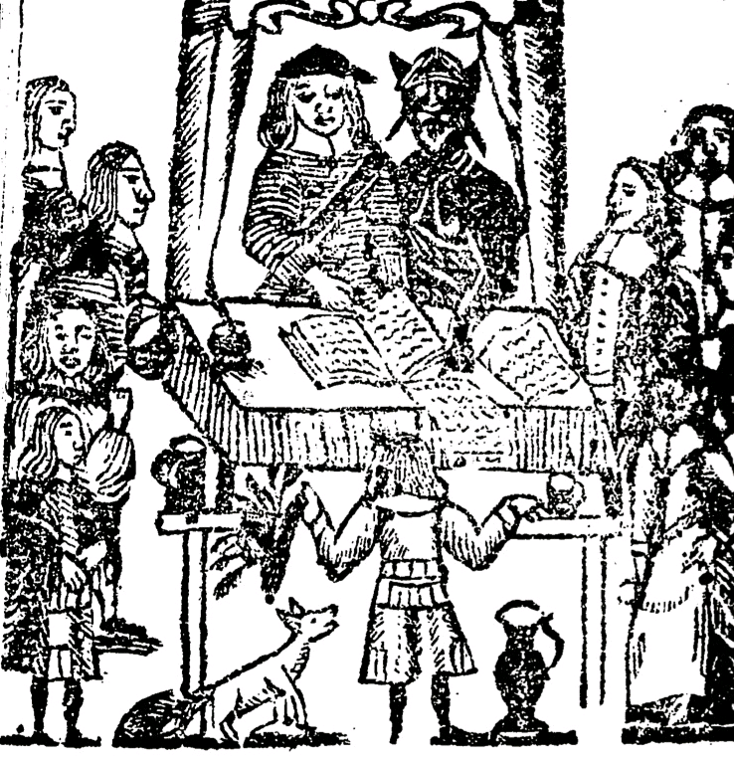
Law: educated theorists from universities
Law as King’s creature, but NOT his pet (not dictator)
Taxation:
King bypasses noble assemblies with civil servants (commoners)
French bailiffs
English justices of peace
Spanish corregidores
food, salt, or sales
Government bonds

Slide 8
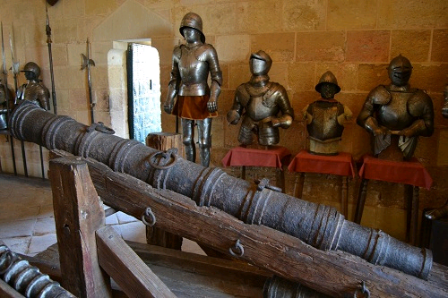
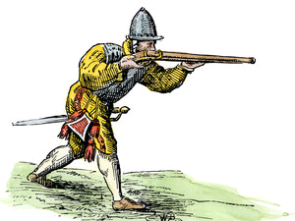
Military revolution
New dominance of firearms and artillery on battlefield (arquebus and cannon)
Results
Mounted knights/castles obsolete
Cost too high for individual lords
Professional army under sovereign
Swiss/German mercenaries for “King’s army”, more reliable than feudal vassals
Fortresses

Slide 9
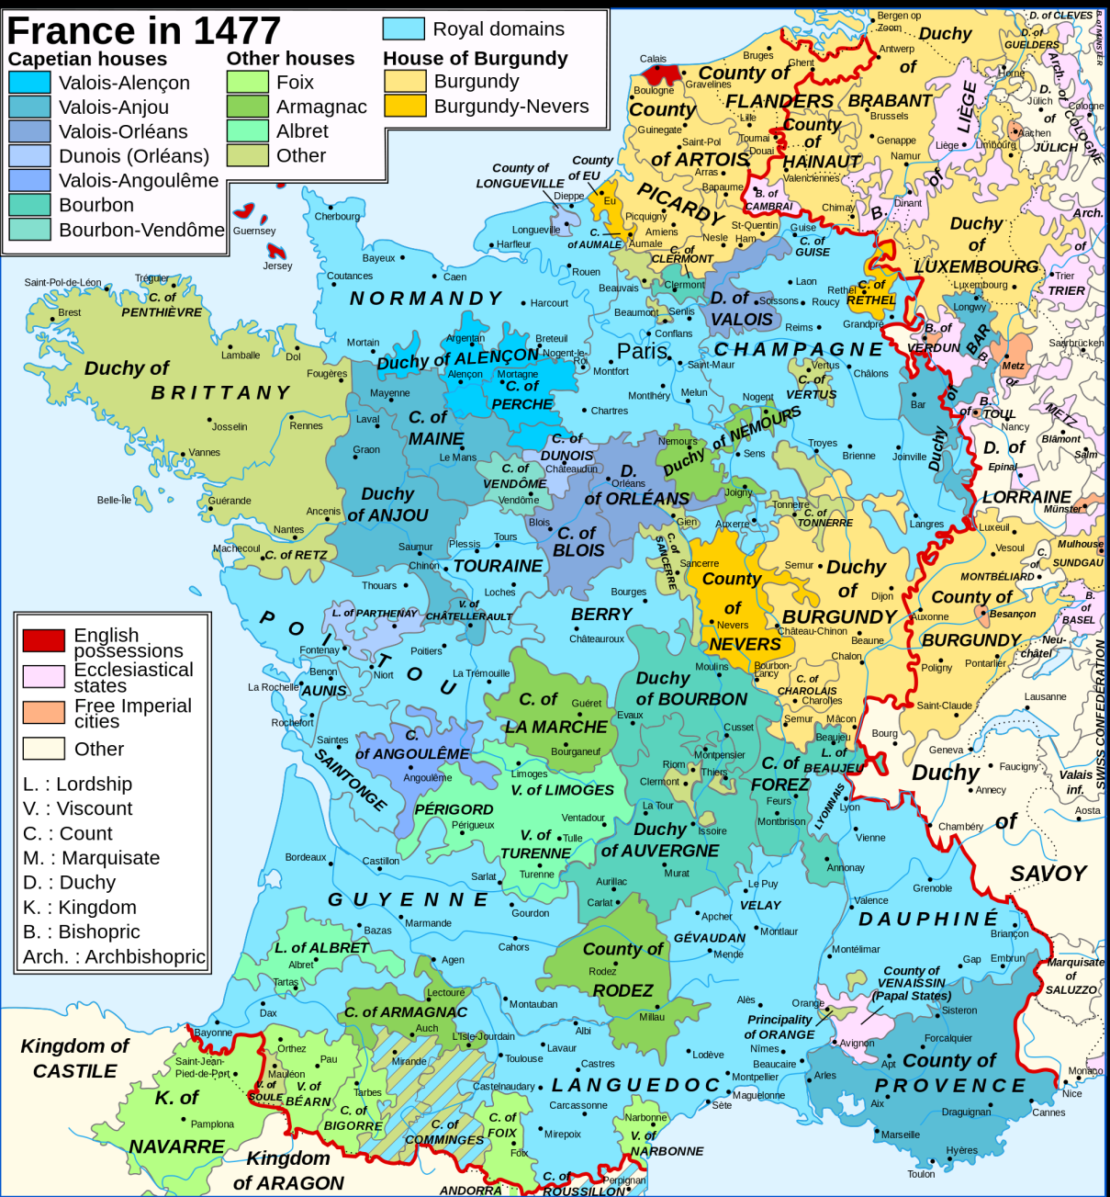
France
Kings Charles VII (r. 1422-61) and Louis XI r. 1461-83
Two victories:
English
Burgundian menace (Charles the Bold)
King Louix XI ends reign with twice the land he starts with

Slide 10
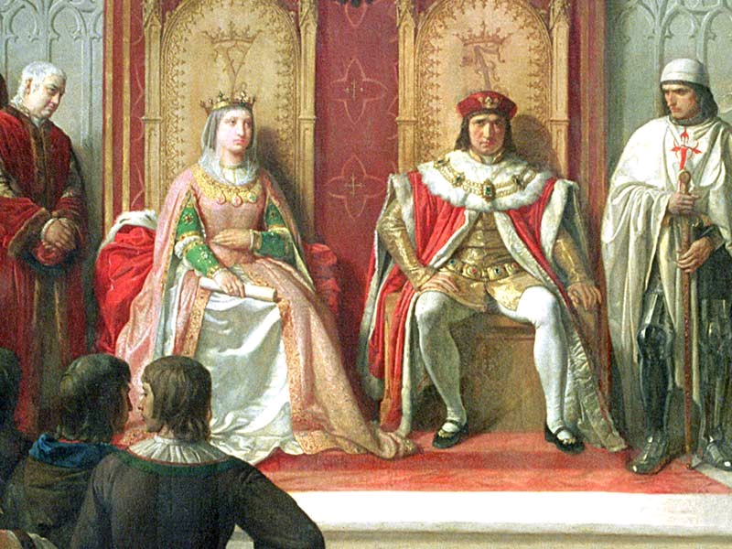
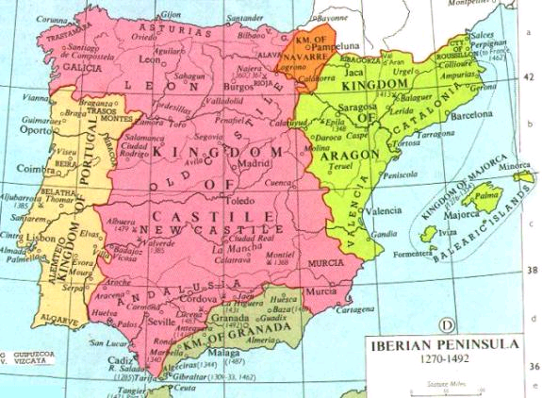
Spain
Poorly ruled and divided
1469: Isabella of Castile and Ferdinand of Aragon marry effectively uniting Spain
Accomplishments:
Conquest of Moors
Controls church, Inquisition
Expel non-converting Jews and Muslims (1492)
Marriage alliances: Hapsburgs and Tudors
Overseas exploration (Columbus), leads to gold/empire

Slide 11
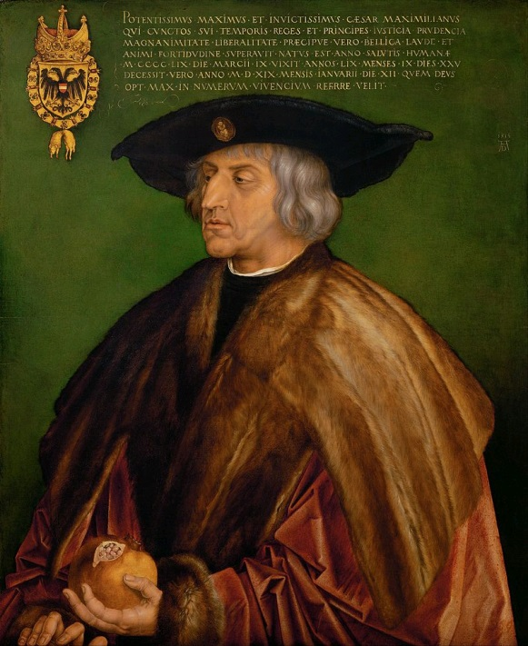
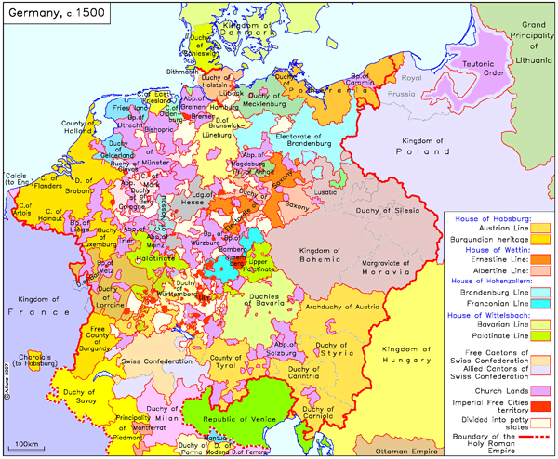
Holy Roman Empire
The Exception
ELECTIVE monarchy, not hereditary
Golden Bull 1356: Established electoral college
HRE renegotiates rights w/electors every election!
Reichstag: control feuding (vendettas!)
None of these reforms really affected matters, barons had too much power (See Protestant Reformation)
Notes:
Archbishops of Mainz, Trier, and Cologne; Duke of Saxony; Margrave of Brandenburg; Count Palatine

Slide 12
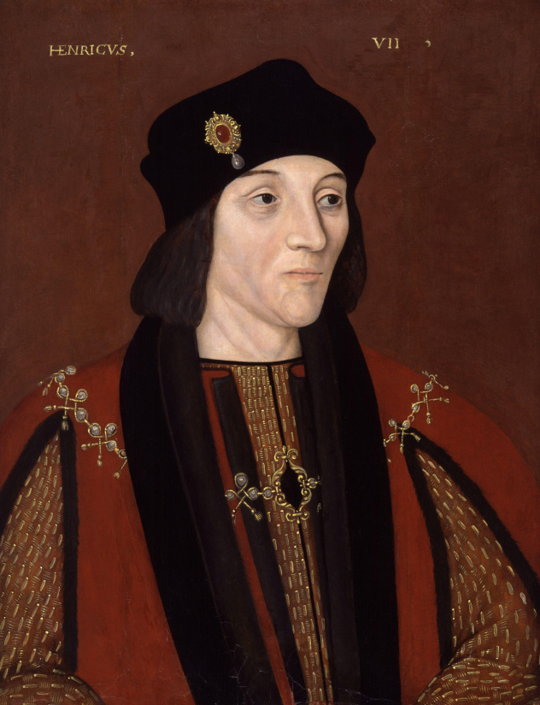
England
Dynastic War of Roses
Enter Henry VII (r. 1485-1509)
New Tudor Dynasty
Court of the Star Chamber: end noble’s perversion of justice
King’s councilors as judges
Confiscates lands and fortunes of old noble enemies

