Slide 1
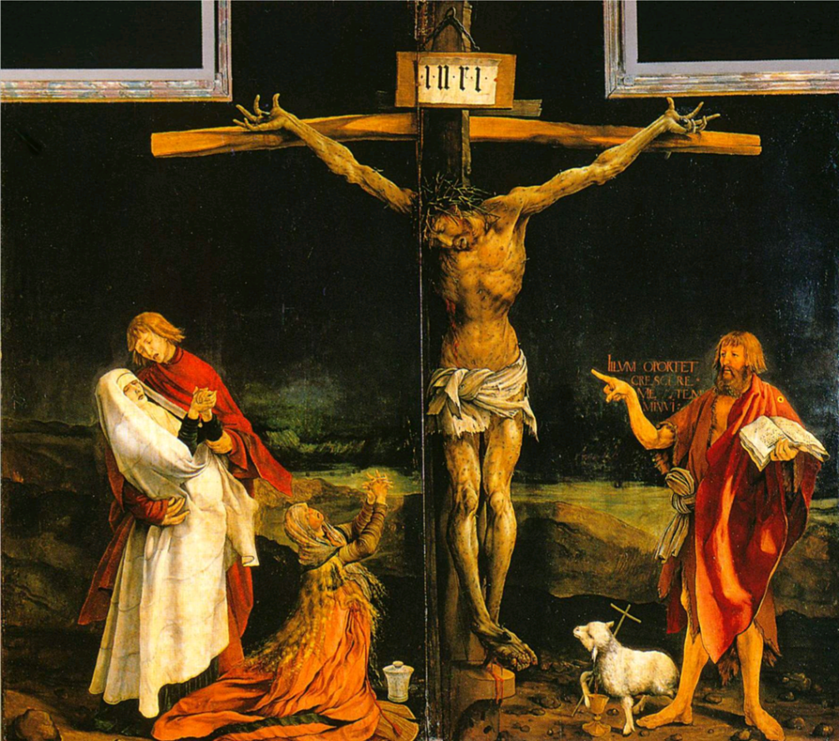
The Flagellation [whipping] of Christ by Piero della Francesca (c.1455-60)
Bellwork Thurs. 8/18
Compare the paintings on: a) subject matter, b) style, c) purpose.
The Crucifixion by Matthias Grünewald (1515-6)

Slide 2
Bellwork Friday 8/19
Follow unpacking procedures.
Turn in your outline notes of the textbook (Kagan).
Write 2-3 sentences summarizing best test-taking techniques with AP Tests.

Slide 3
The Flagellation of Christ byPiero della Francesca (c.1455-60)

Slide 4
The Crucifixion by Matthias Grünewald (1515-6)

Slide 5
Cornelis Aerentsz van der Dussen by Jan Van Sorel (c.1535)

Slide 6
The Fall of Icarus from school of Pieter Bruegel the Elder (c.1560)

Slide 7
Northern Renaissance and Late Medieval Spirituality
I. Renaissance spread to Northern Europe (France, H.R.E., Low Countries, England) in late 15C
Students studying in Italy
Merchants who traded there
Brothers of the Common Life
Northern humanists come from more diverse social backgrounds, focus on religious reform
Write for lay audiences, not just fellow intellectuals

Slide 8
Northern Renaissance and Late Medieval Spirituality
II. Printing press
Johannes Gutenberg- moveable type press, c. 1450.
With cheap printing comes whole new audience for books (people can learn to read when books are readily available)
By 1500, presses are in 60 German cities, more than 200 cities throughout Europe.
Anyone who can read now instant authority…

Slide 9
Northern Renaissance and Late Medieval Spirituality
III. Other preludes to Reformation
Black Death
Social unrest
Breakdown feudal system
Great Western Schism
Council of Constance-
Conciliarism: Councils > Popes
Put down politically within Church, but doesn’t stop political/theological thinkers from holding on to opinion and teaching it

Slide 10
Northern Renaissance and Late Medieval Spirituality
Heresy
Jan Huss of Bohemia: give bread AND wine to laity
Donatism: sincerity of faith > formal office in church
Says sacrament not valid if priest not holy

Slide 11
Northern Renaissance and Late Medieval Spirituality
IV. Papacy
Politically powerful, hierarchy controls vast lands across Europe (tithes, benefices, indulgences)
Critics: Renaissance Papacy thinks worldly prestige > salvation of souls
VI. Lay Piety Movements: Brothers of the Common Life
Did not take vows of chastity, poverty, obedience
Desire for authenticity in faith
Thomas a Kempis- The Imitation of Christ

